Slide 1
Predicting pH for ABC Beverage
DATA 624 | Glen Dale Davis & Tora Mullings

Slide 2
Introduction:
Our analysis of the relationship between pH and the attributes ABC Beverage measures for its products has revealed:
The five most relevant features when accurately predicting pH are:
ALCH_REL | DENSITY | MNF_FLOW | BOWL_SETPOINT | BALLING
The best of 15 models for predicting pH is a Support Vector Machines (SVM) Model that utilizes the above features and others and relies on K Nearest Neighbors (KNN) imputed data for missing values in observations
Other models using the same data performed at least 10% worse

Slide 3
Model Development Process
We built models in three broad categories:
linear: Multiple Linear Regression
nonlinear: Multivariate Adaptive Regression Splines (MARS), K Nearest Neighbors (KNN), and Support Vector Machines (SVMs)
tree-based: Single Regression Trees
These models were all trained and tested on three different sets of data:
primary: missing values in observations were imputed
secondary: observations with missing values were deleted
tertiary: missing values in observations were imputed and skewed predictors were transformed

Slide 4
Model Selection Process
Our primary concerns in model selection were:
performance accuracy, so we only considered the models with the lowest Root Mean Squared Error (RMSE)/highest Predictive R-Squared on each dataset as final contenders
Our secondary concern was:
applicability, so we chose a model that could handle observations with missing values over a model that performed better, but could not handle missing values

Slide 5
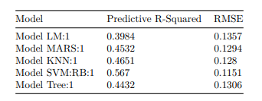
Final Model Metrics
Model SVM:RB:1 was selected as the final model for predicting pH. It had the lowest RMSE and the highest Predictive R-Squared among its peers:

Slide 6
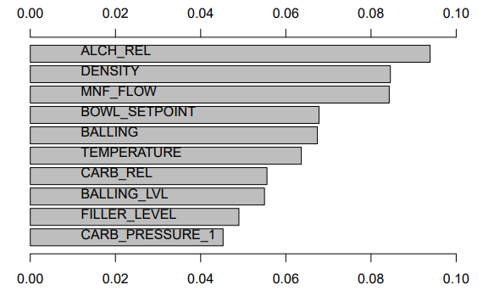
Final Model Feature Importance
This nonlinear model relies on features for predicting pH that some of the linear models could not utilize effectively. Their relative importance is depicted below:

Slide 7
Conclusions
Nonlinear regression methods outperformed linear and tree-based regression methods in this application
Transformations were not useful in improving model performance
The search for the best model was by no means exhaustive, and research should continue using SVM:RB:1 as the new baseline

